Slide 1
DOM (Document Object Model)

Slide 2
DOM & DHTML
Dynamic web pages with JavaScript and DOM
  DHTML (Dynamic HTML)
DOM nodes and DOM tree
Traversing, editing and modifying DOM nodes
Editing text nodes
Accessing, editing and modifying elements' attributes

Slide 3
Introducing the
Document Object Model
JavaScript arranges objects in a Document Object Model or DOM.
The DOM defines the logical structure of objects and the way an object is accessed and manipulated.
The document object model can be thought of as a hierarchy moving from the most general object to the most specific.

Slide 4
DOM Objects
DOM components are accessible as objects or collections of objects
DOM components form a tree of nodes
  relationship parent node – children nodes
  document is the root node
Attributes of elements are accessible as text
When a web page is loaded, the browser create a DOM of the page.

Slide 5

DOM – Tree of objects

Slide 6
DOM Concept
DOM makes all components of a web page accessible
  HTML elements
  their attributes
  text
They can be created, modified and removed with JavaScript

Slide 7
Object Model
With the object model, JavaScript gets all the power it needs to create dynamic HTML:
JavaScript can change all the HTML elements in the page
JavaScript can change all the HTML attributes in the page
JavaScript can change all the CSS styles in the page
JavaScript can remove existing HTML elements and attributes
JavaScript can add new HTML elements and attributes
JavaScript can react to all existing HTML events in the page
JavaScript can create new HTML events in the page

Slide 8
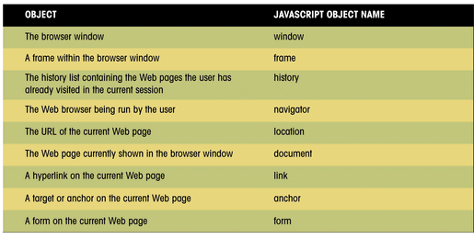
Some JavaScript Objects and
Their Object Names
This figure shows a list of the many objects available in JavaScript
and their corresponding object names.

Slide 9
Accessing Nodes by id
Access to elements by their id
  document.getElementById(<id>)
    returns the element with id <id>
  id attribute can be defined in each start tag
    div element with id attribute can be used as an root node for a dynamic DOM subtree
    span element with id attribute can be used as a dynamic inline element
    The preferred way to access elements

Slide 10
Other Access Methods
Access by elements' tag
      there are typically several elements with the same tag
  document.getElementsByTagName(<tag>)
    returns the collection of all elements whose tag is <tag>
    the collection has a length attribute
    an item in the collection can be reached by its index
  e.g.
    var html = document.getElementsByTagName("html")[0];
Access by elements' name attribute
      several elements can have the same name
  document.getElementsByName(<name>)
    returns the collection of elements with name <name>

Slide 11
Object Collections
Another way to reference an object and that is with an object collection.
An object collection is an array of all objects of a particular type, such as all of the hyperlinks for a single document or all of the elements within a single form.
An item from an object collection can be referenced in one of three ways:
  collection[i]
  collection[“name”]
  collection.name
  collection is the JavaScript name of the collection
  i is an index number of the item in the collection
  name is the name assigned to the object using the name attribute

Slide 12
Traversing DOM tree
Traversal through node properties
  childNodes property
    the value is a collection of nodes
      has a length attribute
      an item can be reached by its index
    e.g. var body = html.childNodes[1];
  firstChild, lastChild properties
  nextSibling, previousSibling properties
  parentNode property

Slide 13
Some JavaScript Object Collections
Collection | Description | Browser Support
 |  | Netscape | IE
document.all | All HTML elements in the document |  | 4.0
document.anchors | All anchor elements in the document | 3.0 | 3.0
document.applets | All Java applets in the document. The applet must be started before being recognized as part of the DOM | 3.0 | 3.0
document.embeds | All embedded objects in the document | 3.0 | 4.0
document.form.elements | All of the elements in the form named form.
document.forms | All forms in the document | 2.0 | 3.0
document.frames | All internal frames in the document |  | 4.0
document.images | All inline images in the document | 2.0 | 3.0
document.links | All hyperlinks in the document | 2.0 | 3.0
document.plugins | All plug-ins in the document |  | 4.0
document.scripts | All scripts (created with the <script> tag) in the document |  | 4.0
This figure lists some of the more commonly used JavaScript object collections.
Not all object collections are supported by all browsers or browser versions.

Slide 14
Other Node Properties
  nodeType property
    ELEMENT_NODE: HTML element
    TEXT_NODE: text within a parent element
    ATTRIBUTE_NODE: an attribute of a parent element
      attributes can be accessed another way
  nodeName property
  nodeValue property
  attributes property
  innerHTML property
  style property
    object whose properties are all style attributes, e.g., those defied in CSS

Slide 15
Accessing JS Object's Properties
There are two different syntax forms to access object's properties in JS (
  <object>.<property>
    dot notation, e.g., document.nodeType
  <object>[<property-name> ]
    brackets notation, e.g., document["nodeType"]
    this is used in for-in loops
this works for properties of DOM objects, too

Slide 16
Attributes of Elements
  Access through attributes property
  attributes is an array
  has a length attribute
  an item can be reached by its index
  an item has the properties name and value
  e.g.
    var src = document.images[0].attributes[0].value;
Access through function getAttribute(<name>)
  returns the value of attribute <name>
  e.g.
    var src = document.images[0].getAttribute("src");

Slide 17
Text Nodes
Text node
  can only be as a leaf in DOM tree
  it’s nodeValue property holds the text
  innerHTML can be used to access the text

Slide 18
Modifying a Property’s Value
The syntax for changing the value of a property is:
  object.property = expression
  object is the JavaScript name of the object you want to manipulate
  property is a property of that object
  expression is a JavaScript expression that assigns a value to the property

Slide 19

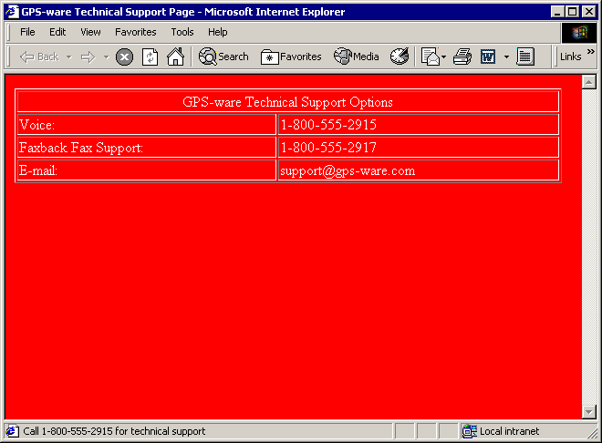
Setting an Object’s Property Value
This figure shows how you can use objects and properties to modify a Web page and Web browser.
JavaScript commands
document.fgColor
document.bgColor
window.defaultStatus
resulting Web page

Slide 20
Changing Properties
Not all properties can be changed.
Some properties are read-only, which means that you can read the property value, but cannot modify it.

Slide 21

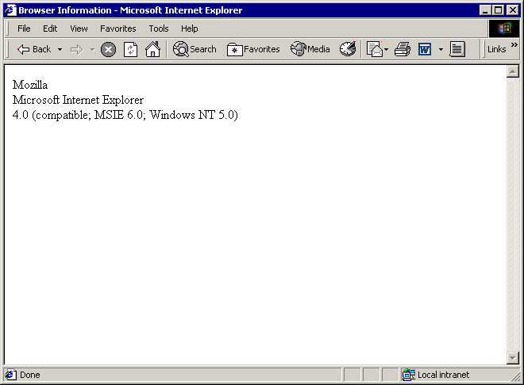
Displaying Some Read-Only
Browser Properties
This figure shows how you can use JavaScript to display
additional read-only information about your browser.
JavaScript commands
browser code name
browser name
browser version
resulting Web page

Slide 22
Assigning a Property to a Variable
Although you cannot change the value of read-only properties, you can assign a value to a variable in your JavaScript program.
The syntax for assigning a property to a variable is:
  variable = object.property
  variable is the variable name
  object is the name of the object
  property is the name of its property

Slide 23
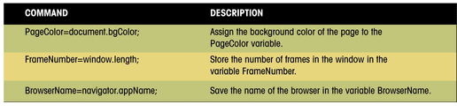
Assigning Property
Values to Variables
This figure shows three examples of property values being assigned to JavaScript variables.

Slide 24
Using Property Values to Variables
A conditional statement changes how the Web page behaves based on the value of an object property.
The following JavaScript code shows how you can incorporate object properties into a simple conditional expression:
  If (document.bgColor==“black”) {
  document.fgColor=“white”;
  } else {
  document.fgColor=“black”;
  }
Using objects, properties, and conditional statement provides a great deal of control over the appearance of a Web page.

Slide 25
Working with Object Methods
Another way to control a Web page is to use methods.
Methods are either actions that objects perform or actions applied to objects.
The syntax for applying a method to an object is:
  object.method(parameters);
  object is the name of the object
  method is the method to be applied
  parameters are any values used in applying the method to the object

Slide 26
Modifying DOM Structure
document.createElement(<tag>)
  creates a new DOM element node, with <tag> tag.
  the node still needs to be inserted into the DOM tree
document.createTextNode(<text>)
  creates a new DOM text with <text>
  the node still needs to be inserted into the DOM tree
<parent>.appendChild(<child>)
  inserts <child> node behind all existing children of <parent> node
<parent>.insertBefore(<child>,<before>)
  inserts <child> node before <before> child within <parent> node
<parent>.replaceChild(<child>,<instead>)
  replaces <instead> child by <child> node within <parent> node
<parent>.removeChild(<child>)
  removes <child> node from within <parent> node

Slide 27
Modifying Node Attributes
<node>.setAttribute(<name>,<value>)
  sets the value of attribute <name> to <value>
  e.g.
    document.images[0].setAttribute("src","keiki.jpg");
That's the standard
  but it doesn't work in IE, there you have to use
    setAttribute(<name=value>)
  e.g.
    document.images[0].setAttribute("src=\"keiki.jpg\"");

Slide 28
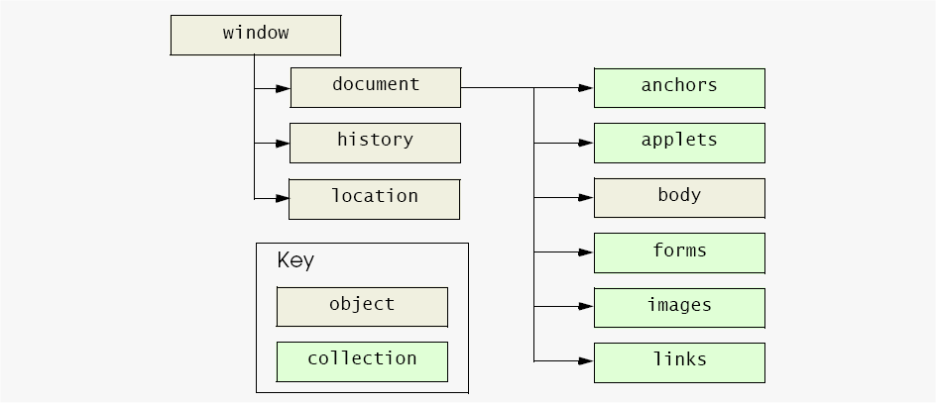
W3C Document Object Model

Slide 29
A Part of the Document Object Model
This figure shows a section of the entire Document Object Model (DOM).
The full DOM would be a much larger figure.
window
frame
event
history
document
location
navigator
screen
document
anchor
form
image
link
style
tag
button
checkbox
input
radio
reset
select
submit
textarea

Slide 30
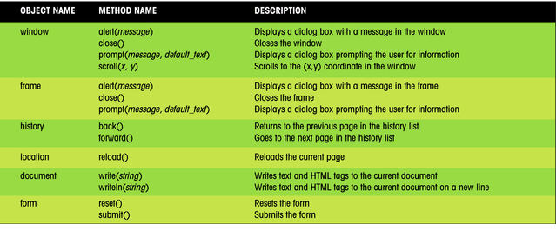
JavaScript Objects and Their Methods
This figure lists some additional JavaScript objects and some of the methods associated with them.
A more complete list of objects, properties, and methods is included in Appendix G.

Slide 31
Special DOM Objects
window
  the browser window
  new popup windows can be opened
document
  the current web page inside the window
body
  <body> element of the document
history
  sites that the user visited
  makes it possible to go back and forth using scripts
location
  URL of the document
  setting it goes to another page

Slide 32
Managing Events
An event is a specific occurrence within the Web browser. For example:
  opening up a Web page
  positioning the mouse pointer over a location on that page
Events are an important part of JavaScript programming, you can write scripts that run in response to the actions of the user, even after the Web page has been opened.

Slide 33
Working with Event Handlers
Events are controlled in JavaScript using event handlers that indicate what actions the browser takes in response to an event.
Event handlers are created as attributes added to the HTML tags in which the event is triggered.
The general syntax is:
  < tag onevent = “JavaScript commands;”>
  tag is the name of the HTML tag
  onevent is the name of the event that occurs within the tag
  JavaScript commands are the commands the browser runs in response to the event

Slide 34
JavaScript Event Holders
This figure describes event handlers that JavaScript provides.
Category | Event Handler | Description | Netscape | IE
Window and Document events | onload | The browser has completed loading the document. | 2.0 | 3.0
 | onunload | The browser has completed unloading the document. | 2.0 | 3.0
 | onabort | The transfer of an image as been aborted. | 3.0 | 4.0
 | onerror | An error has occurred in the JavaScript program. | 3.0 | 4.0
 | onmove | The user has moved the browser window. | 4.0 | 3.0
 | onresize | The user has resized the browser window. | 4.0 | 4.0
 | onscroll | The user has moved the scrollbar. |  | 4.0
Form events | onfocus | The user has entered an input field. | 2.0 | 3.0
 | onblur | The user has exited an input field. | 2.0 | 3.0
 | onchange | The content of an input field has changed. | 2.0 | 3.0
 | onselect | The user has selected text in an input or textarea field. | 2.0 | 3.0
 | onsubmit | A form has been submitted. | 2.0 | 3.0
 | onreset | The user has clicked the Reset button. | 3.0 | 4.0
Keyboard and Mouse events | onkeydown | The user has begun pressing a key. | 4.0 | 4.0
 | onkeyup | The user has released a key. | 4.0 | 4.0
 | onkeypress | The user has pressed and released a key. | 4.0 | 4.0
 | onclick | The user has clicked the mouse button. | 2.0 | 3.0
 | ondblclick | The user has double-clicked the mouse button. | 4.0 | 4.0
 | onmousedown | The user has begun pressing the mouse button. | 4.0 | 4.0
 | onmouseup | The user has released the mouse button. | 4.0 | 4.0
 | onmousemove | The user has moved the mouse pointer. | 4.0 | 4.0
 | onmouseover | The user has moved the mouse over an element. | 2.0 | 3.0
 | onmouseout | The user has moved the mouse out from an element. | 3.0 | 4.0

Slide 35

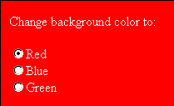
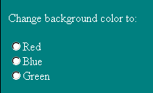
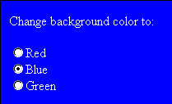
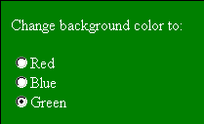
Using the Onclick Event Handler
This figure shows an example of the onclick event handler used with a collection of radio buttons.
When the user clicks a radio button, the click event is initiated and the onclick event handler instructs the browser to run a JavaScript command to change the background color of the Web page.
JavaScript commands
users clicks the red button
users clicks the blue button
initial Web page
users clicks the green button

